Slide 1
Human-Centered Artificial Intelligence (HCAI)
Fundamentals & Differences with Traditional Human-computer Interaction

Slide 2
Overview
Recap Extended Mind
Recap Network-enabled cognition

Slide 3
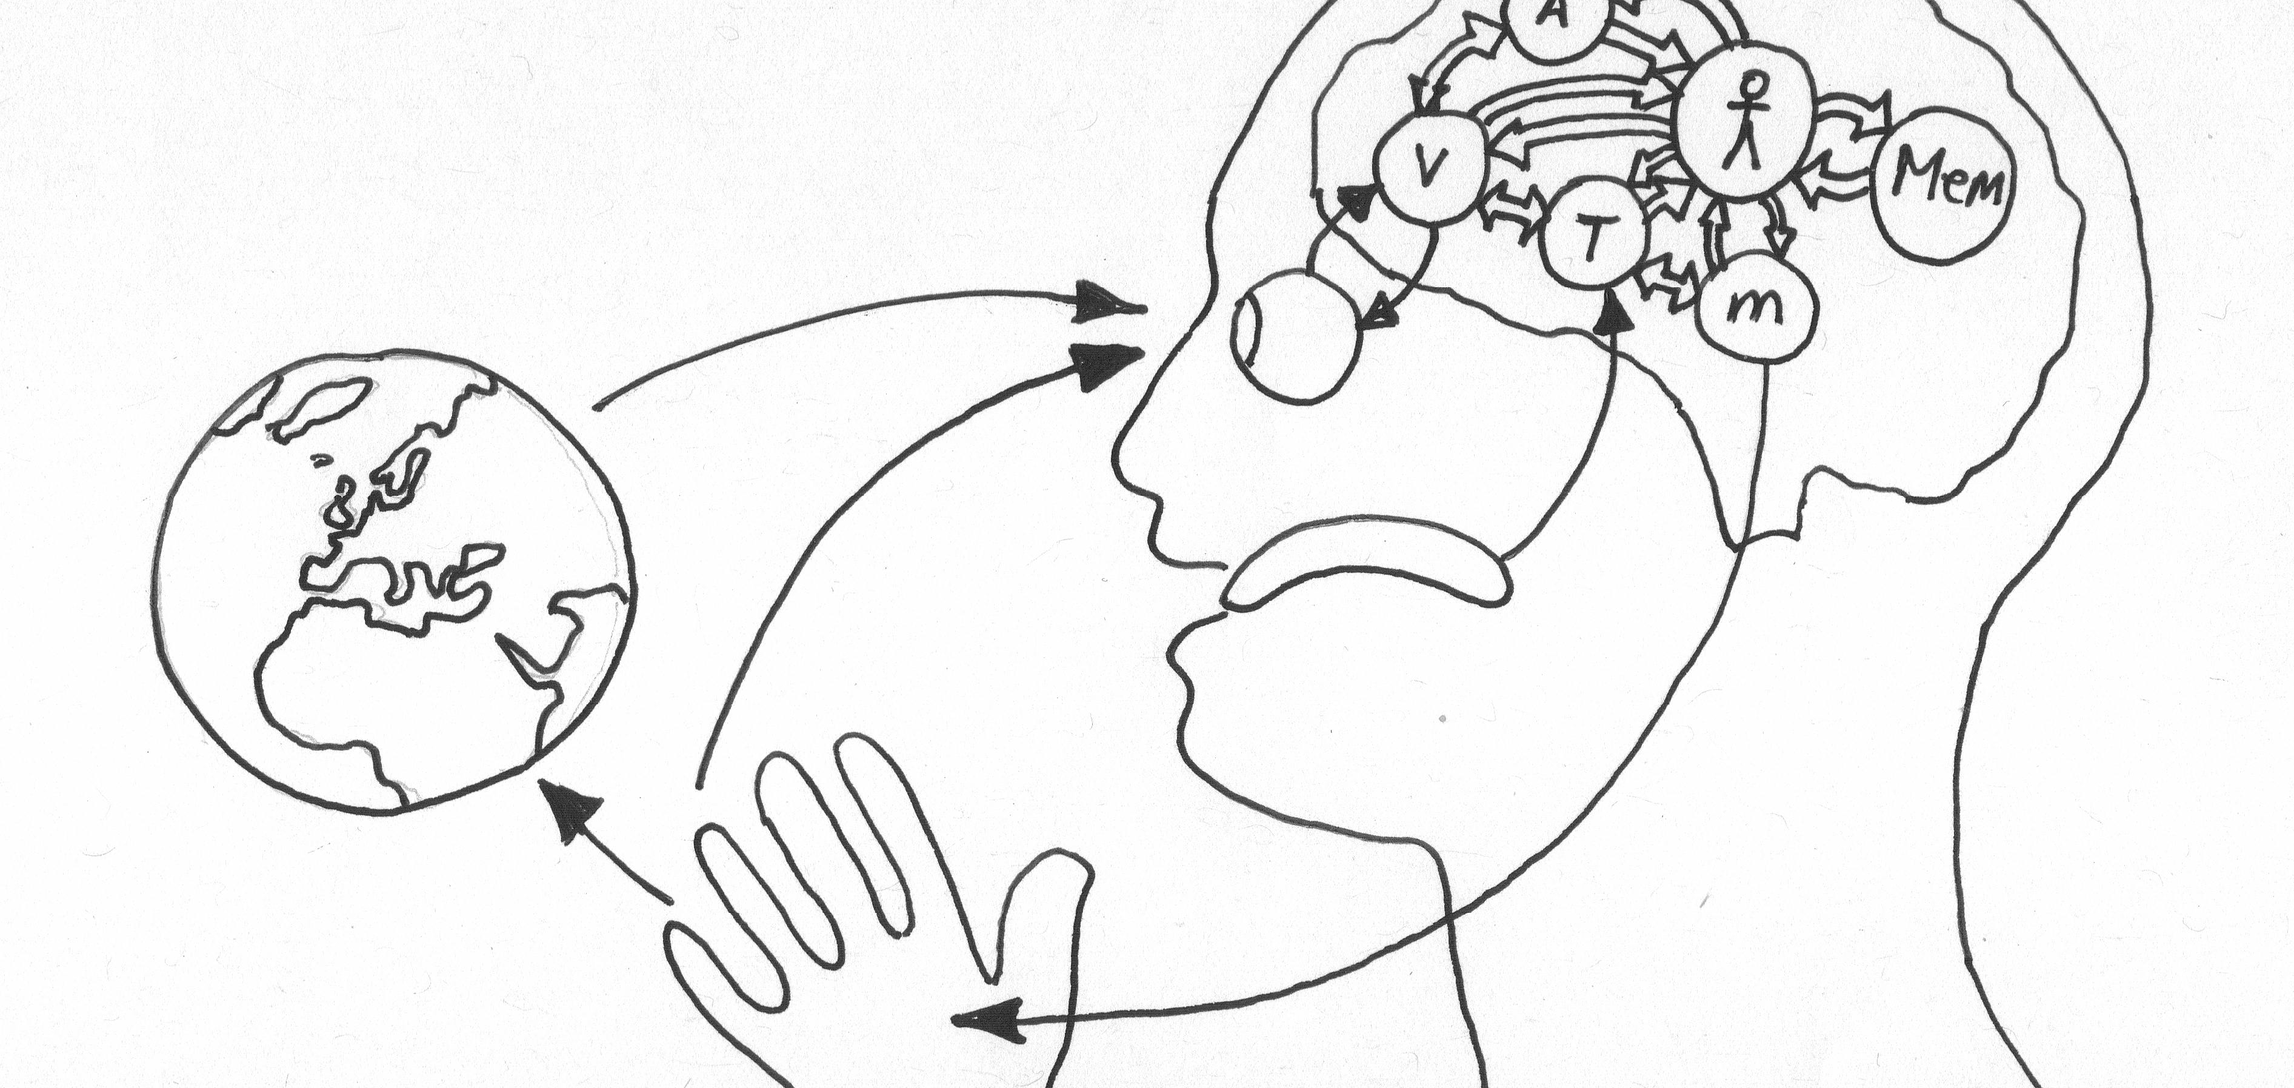
Extended Mind Theory
Objects in the external environment can be part of a cognitive process and in that way function as extensions of the mind itself.
Notes:
What is does extended mind theory state? Or what is an extended mind?
[click to add definition]
Can you name some examples of mind extensions?
What is the difference between the mind and the consciousness?
What is the value of Extended Mind Theory for Human Computer interaction?
Why is this perspective valuable for design human-computer interaction?
What are the implications for Human-centered Artificial Intelligence?

Slide 4
Network Enabled Cognition Theory
The technological and informational elements of a large-scale information network can, under certain circumstances, constitute part of the material supervenience base for an agent’s mental states and processes.
Notes:
What is Network Enabled Cognition Theory?
[click to add definition]
Can you name examples of networked enabled cognition?
What is the value of Network Enabled Cognition for Artificial Intelligence?

Slide 5
Interaction
Communication or direct involvement with someone or something: a reciprocal action or influence
Notes:
What is interaction?
[click to add definition]
Why is interaction central to cognition?

Slide 6
Human-Centered Artificial Intelligence
Design discipline within artificial intelligence for designing applications that are reliable, safe, and trustworthy, and effectively serve people's needs.
Notes:
Machine learning (ML) is the science of helping computers discover patterns and relationships in data instead of being manually programmed. It’s a powerful tool for creating personalized and dynamic experiences, and it’s already driving everything from Netflix recommendations to autonomous cars. But as more and more experiences are built with ML, it’s clear that UXers still have a lot to learn about how to make users feel in control of the technology, and not the other way round.
What is HCAI?
[Click to add definition]

Slide 7
HCAI Fundamentals
AI isn’t going to solve your problems for you
Hype causes unrealistic expectations
Meaningful problems are foundational; otherwise AI might be overkill
Finding a meaningful problem still requires you to do the research and interpreation

Slide 8
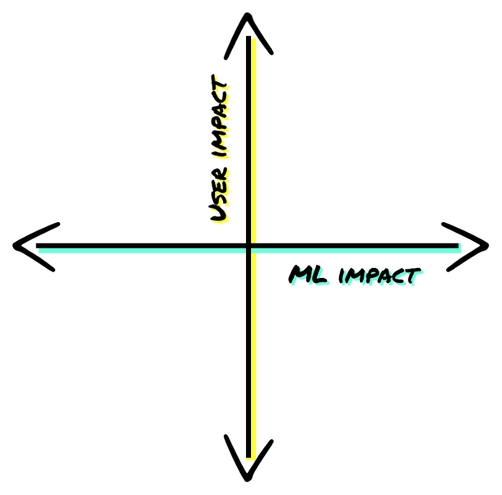
HCAI Fundamentals
Not every problem can be solved meaningfully using ML
Ask yourself whether an ML solution actually adds a meaningful contribution
Sometimes a heuristic AI can work just as well or better; e.g. good regression model
Sometimes an AI isn’t needed in the first place, not even a heuristic one like a reactive state machine
Does implementation an AI actually adds a unique value? Is there a faster route?

Slide 9
HCAI Fundamentals
Not every problem can be solved meaningfully using ML
How do I find out? Ask yourself:
How would you describe the way a theoretical human "expert" might perform the task today?
If your human expert were to perform this task, how would you respond to them so they improved for the next time?
If a human expert were to perform this task, what assumptions would the user want them to make?

Slide 10
HCAI Fundamentals
Prototype your AI: Fake it
Users will expect that an AI anticipate what it should do; how it should respond
Essentially, it expects it to respond like a (rudimentary) human; ‘intelligently’
Methods:
Interview: how did conventional intelligent agents (usually humans) help the user? → Identify good features & needs (status quo)
Wizzard of Oz – Studies are great to test features & actual needs (test projected needs)

Slide 11
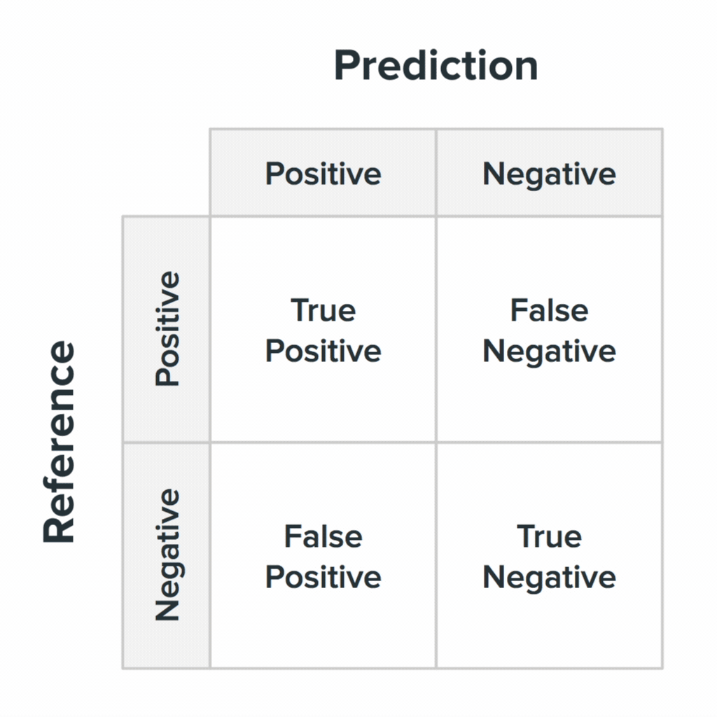
HCAI Fundamentals
Weigh the costs of false positives and false negatives
Confusion matrices again!
What is the cost of a false positive?
What is the cost of a false negative?
Where do you priorities lie?
Very important! But, already covered in other parts of this course so let’s not dive into it here.

Slide 12
HCAI Fundamentals
Plan for co-learning and adaptation
ML systems evolve over time!
Does you Instagram/tik-tok feed look the same now as it did 1 year ago?
People change and your AI should change with them; it’s like a good relationship where people change together: they keep growing together

Slide 13
HCAI Fundamentals
Plan for co-learning and adaptation
Longitudinal effects?
Often looks at pictures of trees
High-touch/Strong effects?
Fruit tree obsession atm
Broad-Reach effects?
People who look at trees often enjoy advertisements about nature
Allow for user feedback
User can act as labelling agent
What else?

Slide 14
HCAI Fundamentals
Teach your algorithm using the right labels
Supervised learning AI? Then this is vital!
With ML there is only so much we can specify; the AI will classify objects ifself
Adverse to being heuristically assigned
How can we do this?
Dataset characteristics (size, quality etc.)
Confidency level to display results
Is it predicting something it’s trained to predict?

Slide 15
HCAI Fundamentals
Teach your algorithm using the right labels
How can we do this?
Make the right assumptions:
“for ________ users in ________ situations, we assume they’ll prefer ________ and not ________.”
Then get your assumptions into a hacky prototype
Get domain experts on board
Human labellers

Slide 16
HCAI Fundamentals
Machine Learning is surprisingly akin to Cooking
There is not set way to solve a problem
There are recipes
But…
A good recipe does not make a good cook
Practice and insight into the process are fundamental; and thereby come intuition

Slide 17
Problems…
Just as any other thing we create, the important thing is that what we create adds value and is therefore useful
Therefore, we first need to identify the problem
This can be a very clear problem → google flights
Or a problem people weren’t aware of they had; something that makes their live easier, give a competitive edge → cell phones
The problem constists of a need and a behavioural pattern
Then, we can identify what would be valuable to solve that problem
What do people need? Human-centered needs
What are other important factors? E.g. Weather, market
Subsequently, we can come up with solution
Can AI solve this problem in a more meaningful way then traditional techniques?

Slide 18
Where does AI fit in?

Slide 19
User-Centered AI
Context dependent; all experiences are, AI responds to the environment
It’s there to help you; like a side-kick (think about robots for example)
AI can:
Self-learn
Anticipate
Respond
(simulate) problem-solving
AI is:
Personal
Familliar
In motion
Friendly
Unobtrusive

Slide 20
User-Centered AI
What does the user anticipate the AI will do?
How does the AI anticipate what the user wants?
→ it’s a relationship; it’s communication
User-centered AI is not about being futuristic but about adding value; being helpful; contributing to network-enabled cognition
Manage expectation: AI cannot do everything but the user often will expect futristic results; emphasize how and where it can help; not that it is AI driven (unless you’re selling to investors)
Cognitive capacity; working memory is very limited (consicous 100 bits, unconsicious 100k bits) ; AI is only limited by the computation capacity available
What information does the user need? Full disclosure isn’t always helpful; limeted might be more useful

Slide 21
AI Algorithm Implementation

Slide 22
Recommender Systems

Slide 23
Adaptive Interfaces
Feedback; let the user know it’s responding to input

Slide 24
Labelling

Slide 25
Crowdsourcing

